Slide 1
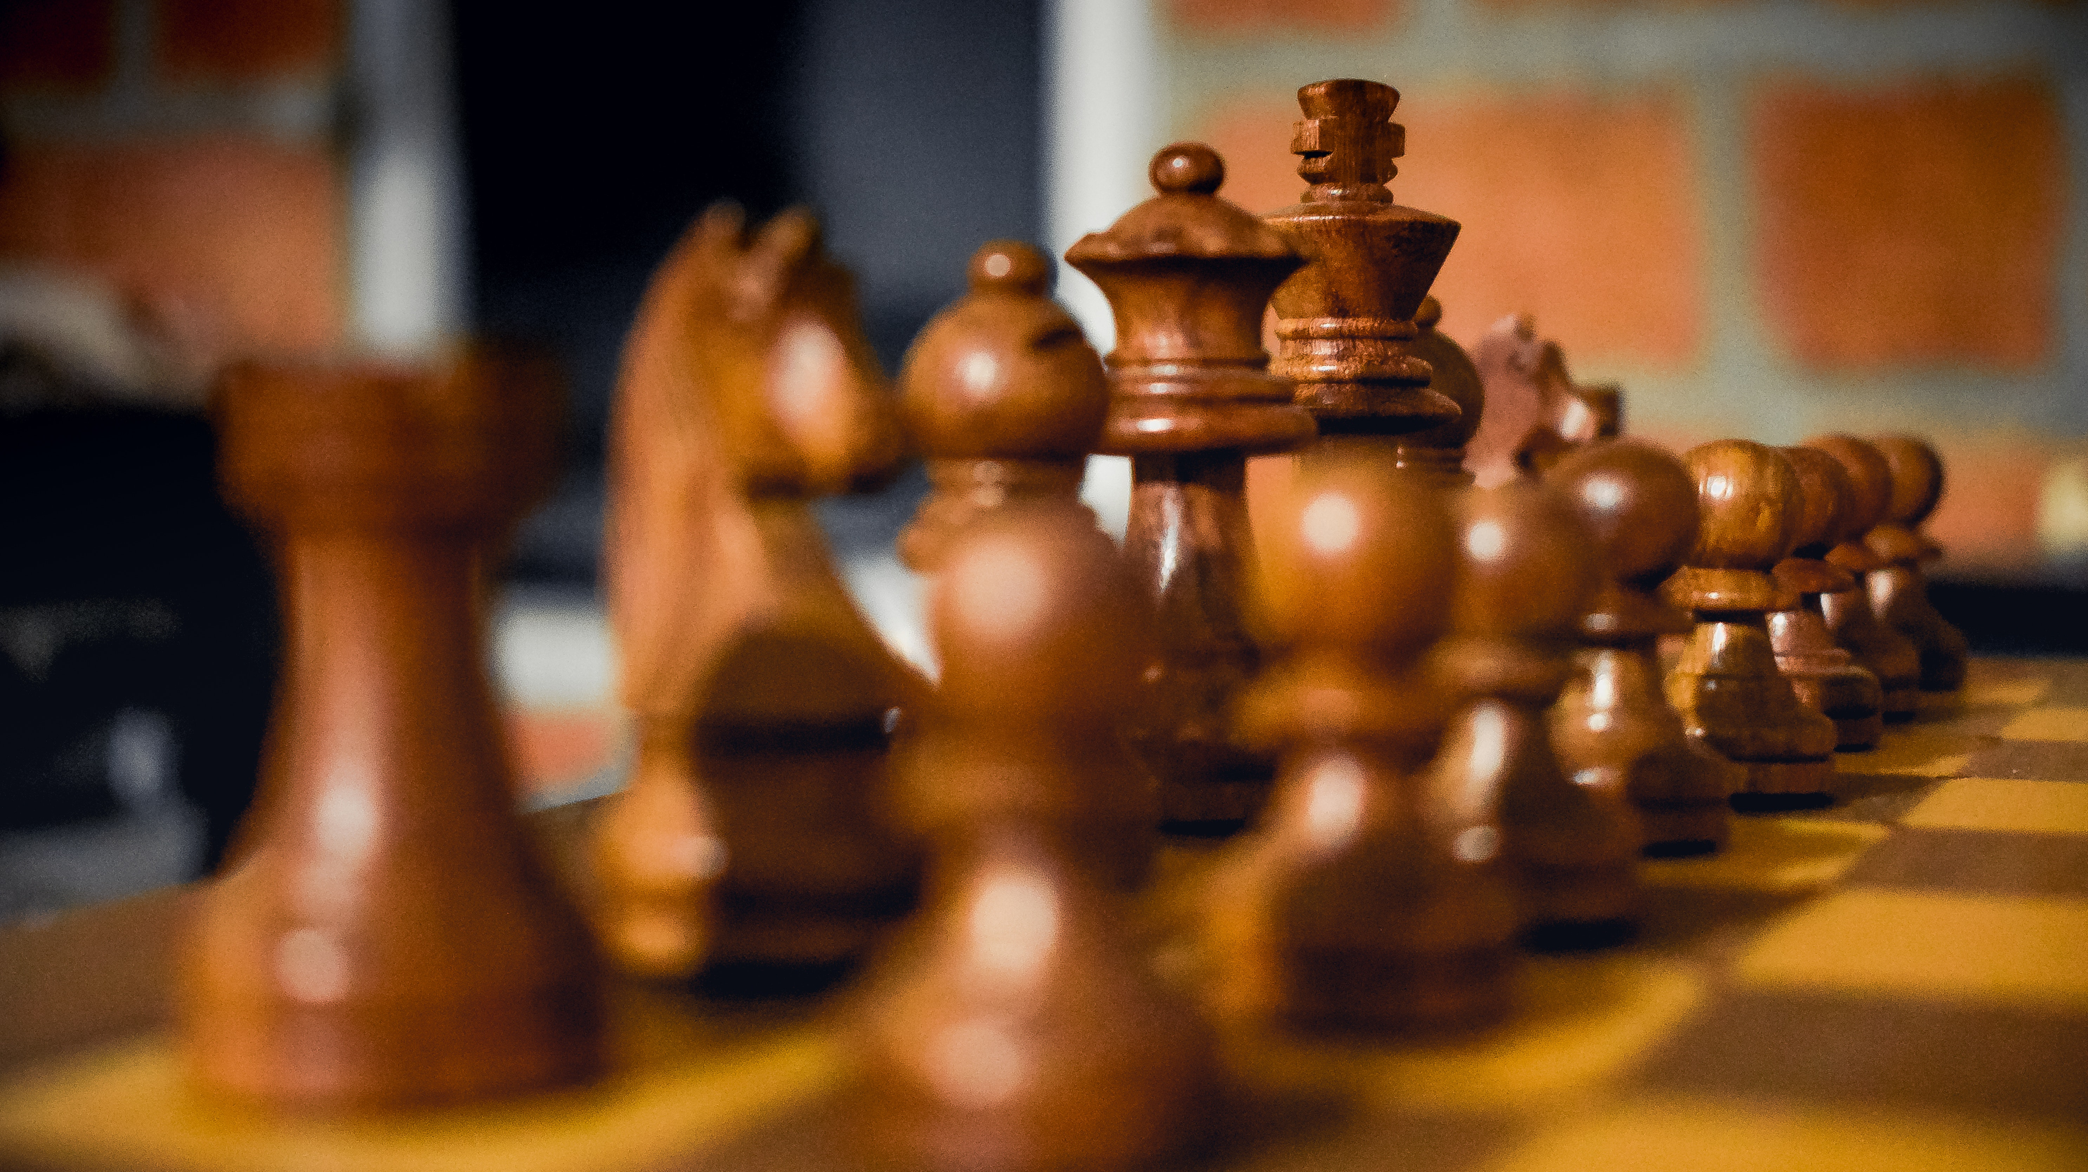
Teaching Chess from scratch
Project for Scientific Programming in Python
By Ellis Lunnon

Slide 2
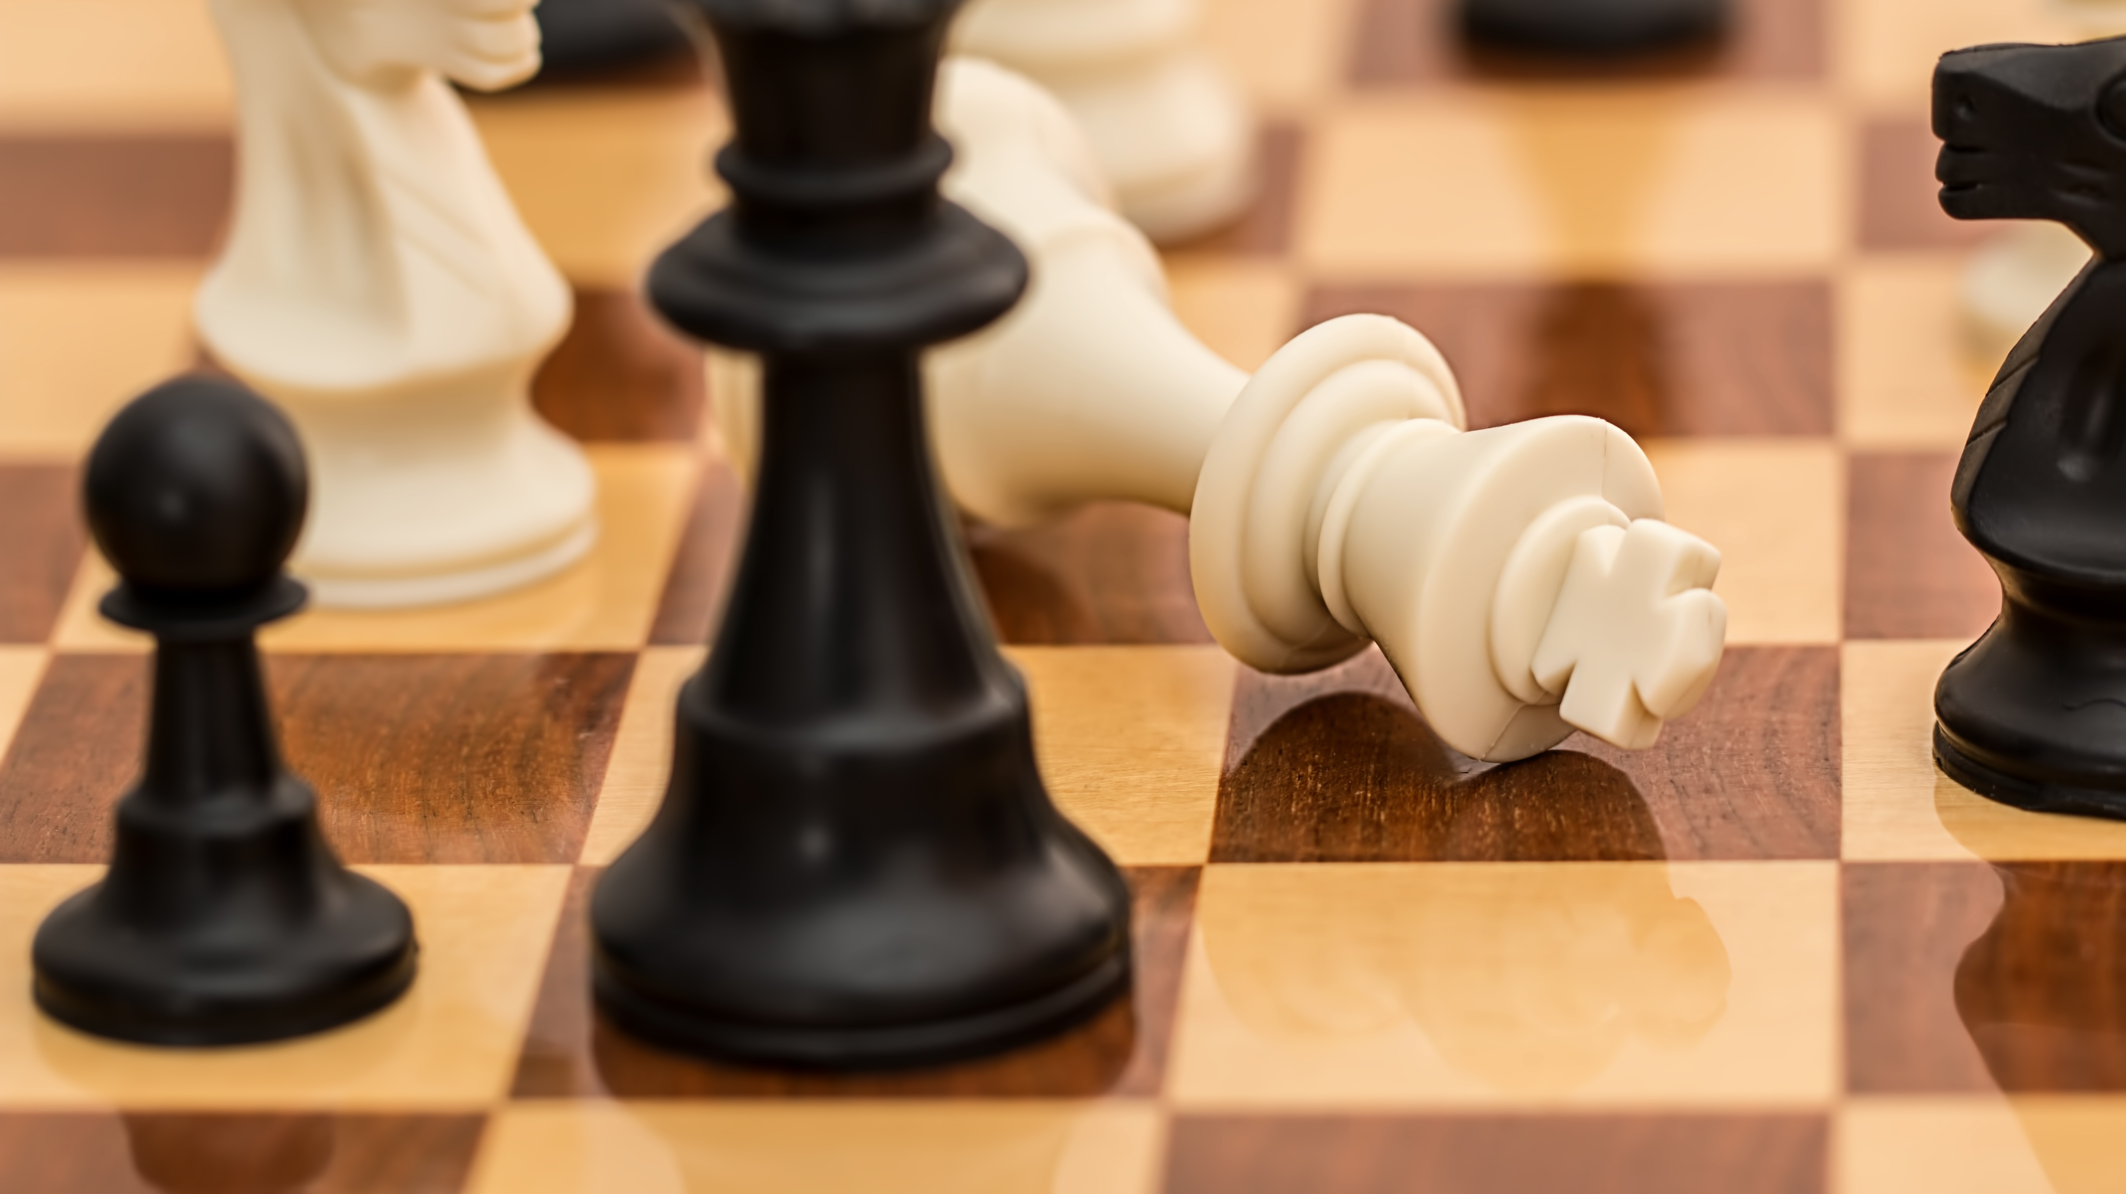
Project Overview
Understand if a machine can be taught the rules of chess based only off the moves it can make and the position of its pieces
Be able to visualize what is understood by a given model, and what behavior is more difficult to define
This requires a significant number of valid positions to learn from
Millions of online chess games are publicly available, but they are not in a format compatible with this task

Slide 3
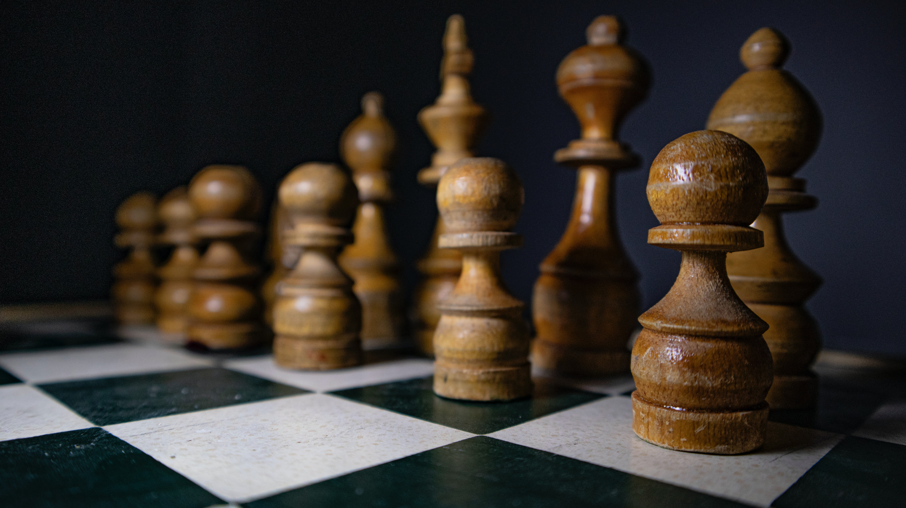
Chess library implementation
The code for this module uses only functions in the Python standard library
Based on a hierarchical object-oriented design
Currently works with (almost) all the rules of the game
Modular design to remove overhead when leveraging this code to make training data

Slide 4

Generating Training Data
Lichess.org provides over 2.7 billion games under the creative commons license
One problem - this format isn't going to work well for this task
Using the library, it's possible to automate the conversion of entire games into single instances of the board
These boards can be used to model the input and output of the network

Slide 5


Learning a model
The model is currently a simple fully connected network with two hidden layers
It takes a flattened $8 × 8$ vector of binary inputs
For each square in the output the model predicts if that square is a valid move on the next turn
Accuracy of the binarized model is currently $≈70\%$

Slide 6
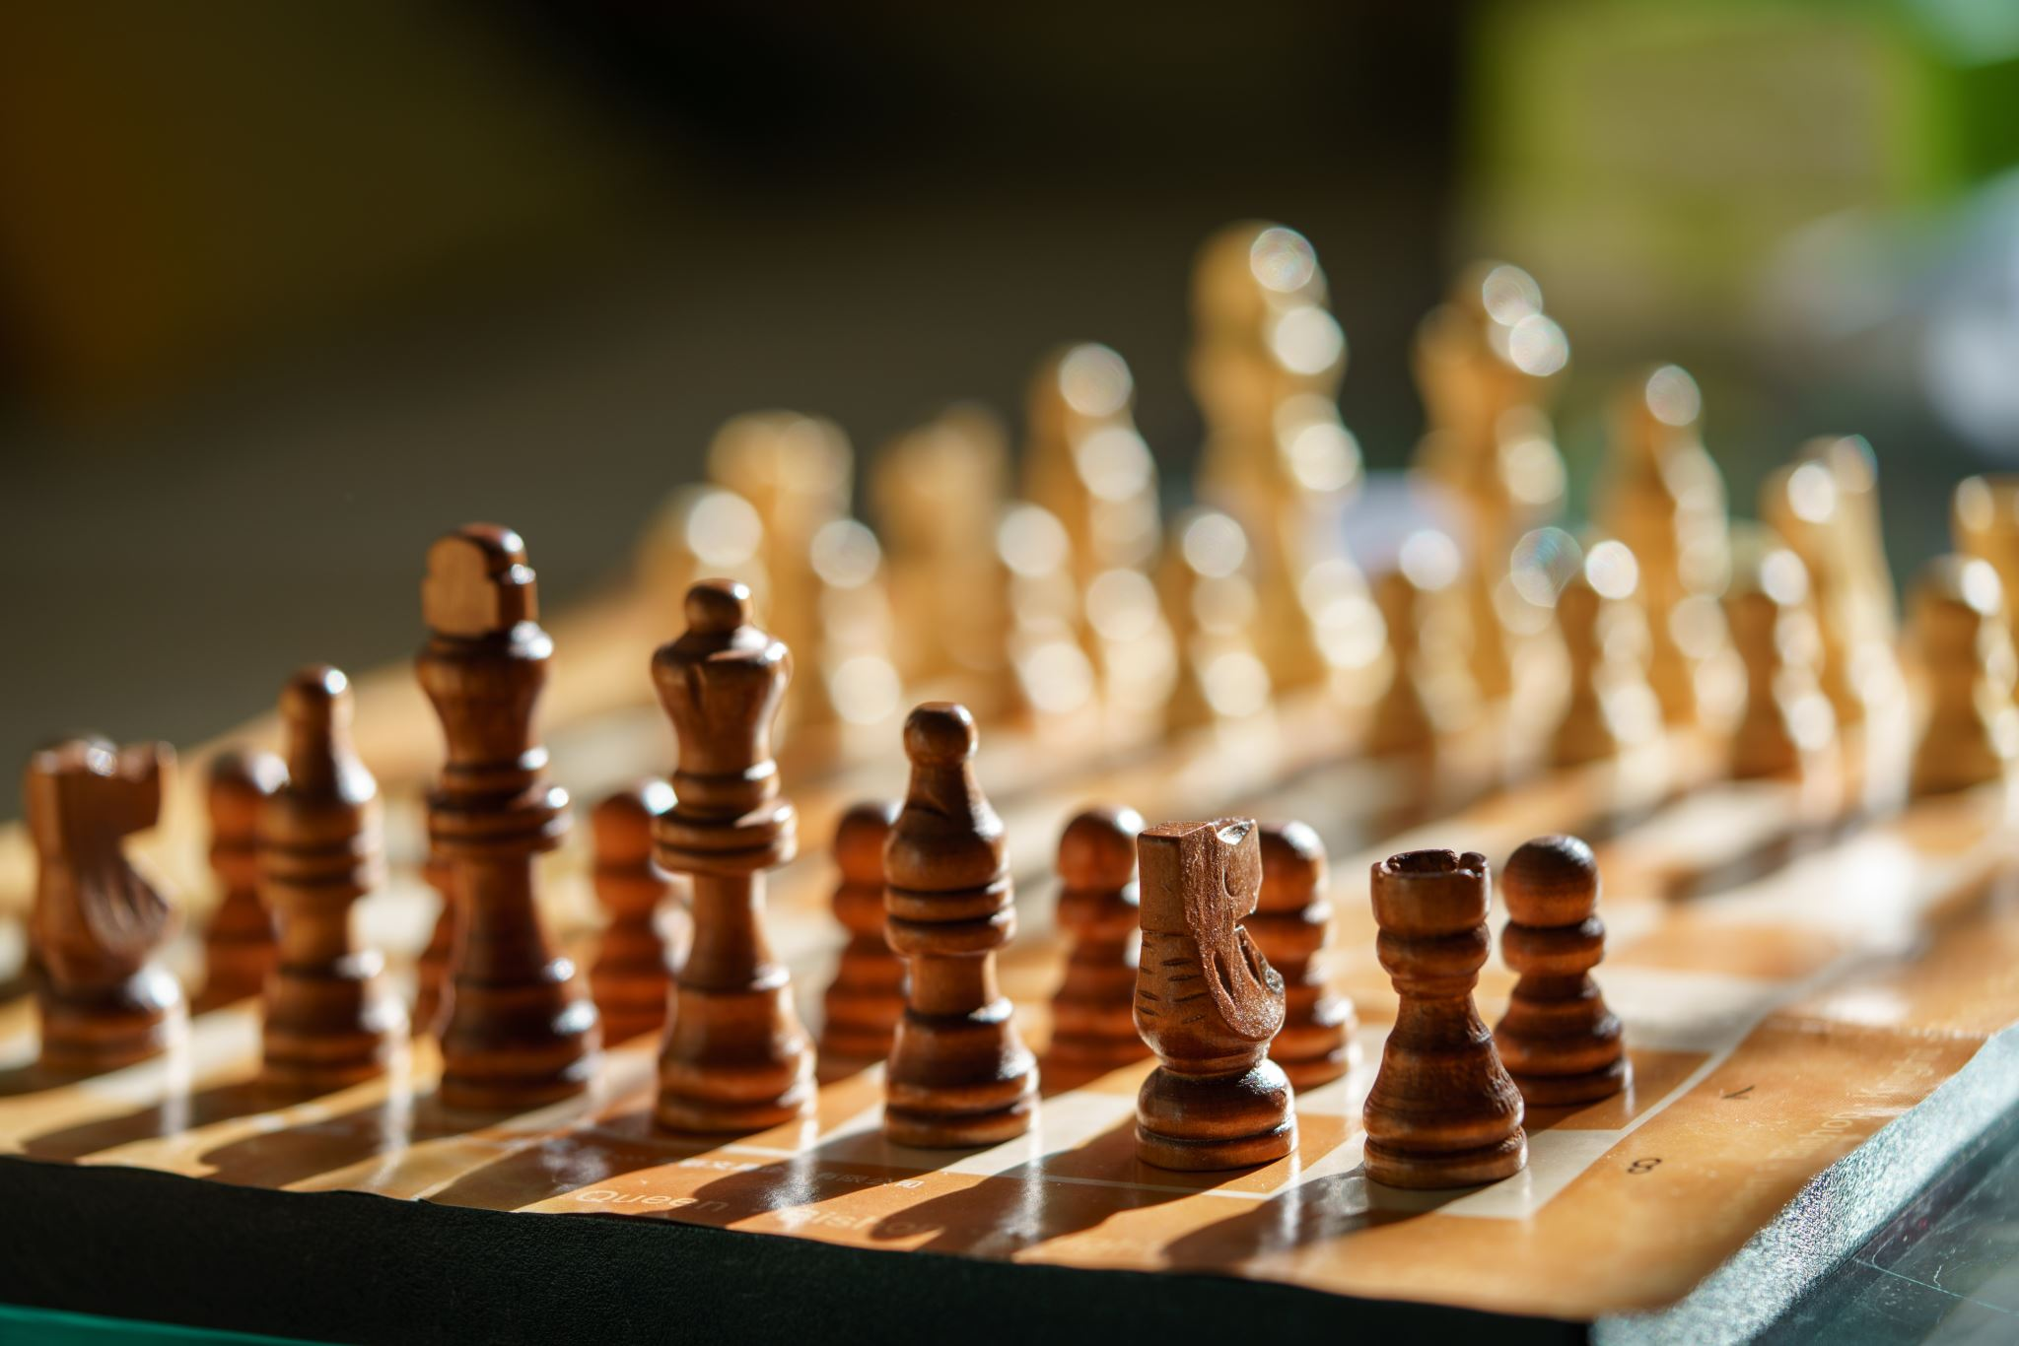

Results and next steps
The current iteration of the design can achieve approximately 70% accuracy on unseen testing examples when trained on $≈1000$ instances
The behavior of pieces which can travel the entire length of the board (Queens, Bishops, Rooks) is not well described in many cases
There is much more information in the training data than the model can currently extract

Slide 7
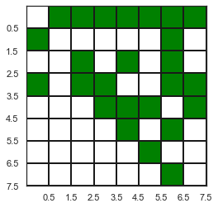
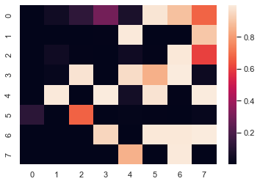
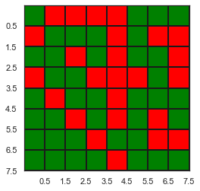
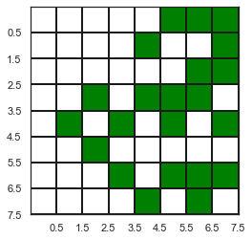
Results and next steps
Fig 1. The networks target
Fig 2. The networks output
Fig 3. The correct and incorrect predictions made by the network
Fig 4. The networks output once binarized

Slide 8
Thank you for listening

